Slide 1
Understanding Firm-Specific Environment

Slide 2
What is Firm-specific environment?
Michael Porter, “ The firm-specific business environment encompasses the internal and external factors that directly affect a company’s competitive position within its industry including its unique resources, capabilities, market positioning, and competitive dynamics”.
Firm specific business environment is composed of the factors inside and outside the business that affect its competitive position significantly.
Unique set of internal and external factors that directly impact a specific company or industry.

Slide 3
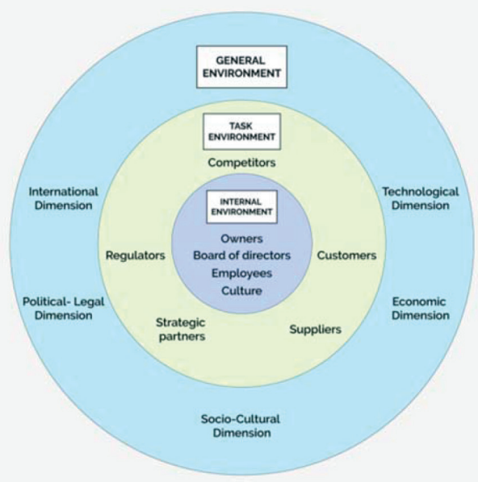
Factors of Firm-specific Environment
1. Internal Factors
A. Organizational Goals and policies
B. Organizational Resources
C. Organizational Structure
D. Organizational Culture
E. Leadership Style
2. External Factors: (Micro/Task Environment)
A. Industry Dynamics
B. Market Position
C. Customer
D. Suppliers
E. Competitors
F. Creditors
G. Media
H. Government
I. Pressure Groups
(Micro/Task Environment)

Slide 4
Importance of understanding the internal dynamics of firms
Strategic Decision making
Competitive advantage
Optimization of operations
Resource allocation
Communication and collaboration
Employee engagement and retention
Adaptation to change

Slide 5
Organizational Structure
An organizational structure details how certain activities are delegated toward achieving an organization's goal. It outlines an employee's role and various responsibilities within a company.
The more authority employees have, the higher up they'll be on the organizational structure.
An organizational structure outlines how responsibilities and roles are assigned and grouped throughout an organization.
An organizational structure is the way that a company, organization, or team is set up. It can be hierarchical, with different levels of management. Or it can be divisional, with different product lines and divisions. Sometimes, there’s little to no hierarchy at all. Every company and team has an organizational structure, even if it’s not formally defined.

Slide 6
Types of Organizational Structure
Simple Organizational Structure: There is a direct line of authority from top level to bottom levels throughout unbroken chain.
Pros: It is simple, decision can be made quickly, proper discipline will be maintained
Cons: There will be overload of work on manager, there will be lack of specialization and is inefficient.
Functional Organizational Structure: All Business activities are divided into a number of functions and each function is entrusted to a specialist.
Pros: Specialized or division of work, Efficient, Relief for managers
Cons: Multiple command system, Lack of coordination, High cost due to multiple departments
Multidivisional Organizational Structure: It is based on multiple business operating within a larger organizational framework. For eg. Chaudhary group of Nepal. The parent company acts as an external overseer to coordinate and control the various divisions.
Pros: Suitable for organizations having diversified business, Facilitates specialization, Effective monitor and evaluation.
Cons: High chances of Conflict, Difficulty in coordination, lack of effective control

Slide 7
Contd..
Geographical Organizational Structure: All activities of specified territory are assigned to a particular department or regional manager. Example of this structure are Banks. Banks operate in various regions of Nepal having a headquarter in one city and braches all over Nepal.
Pros: Environmental adaptation, Able to penetrate different markets and meet the demand of customers effectively.
Cons: Difficult to maintain control, lack of skilled and efficient persons to take charge of regional departments.
Matrix Organizational Structure: This structure is formed to complete various types of projects of specific and unique nature. Matrix structure integrates the efforts of functional and project authority.
Pros: Better coordination and control, adaptable to dynamic environment, Participative management
Cons: Expensive, Violation of unity of command i.e. more than one boss or senior, over-specialization
Committee Organizational Structure: In this structure management takes decisions and solves problems in accordance with the information and suggestions provided by the committee. Committee is common in modern and large scale organizations to solve complex problems and issues.

Slide 8
Contd..
Team-Based Organizational Structure: It is an approach to organizational design that emphasizes almost exclusively on project type teams having little and some case no functional hierarchy. Works are divided into various projects or units and each project work is entrusted to a team having dedicated and efficient members.
Network Structure: It is also called virtual or non-structure. It is a series of independent business units linked together by computers information system that designs, produces and markets a product or service.
Multinational company structure: These are internationalized companies. These companies adopt global approach in their management and decision making. Organizational design and structure are determined by global environment so it is highly flexible in terms of structure.

Slide 9

Organizational Culture
Organizational culture is the set of values, beliefs, attitudes, systems, and rules that outline and influence employee behavior within an organization.
Culture affects how people experience an organization—that is, what it’s like for a customer to buy from a company or a supplier to work with it. It shows up in company policies such as dress code and office hours.
It also informs things such as workspace design and employee perks. Culture is usually set by a company’s leaders.
In a historical context, this could be considered the cultural equivalent of the rituals, rites, symbols, and stories o
By today’s standards, organizational culture usually refers to the mutual outlook, assumptions, and standards of an organization’s membership. Organizational culture determinants include an organization’s structure, leadership, mission, and strategy of people.

Slide 10
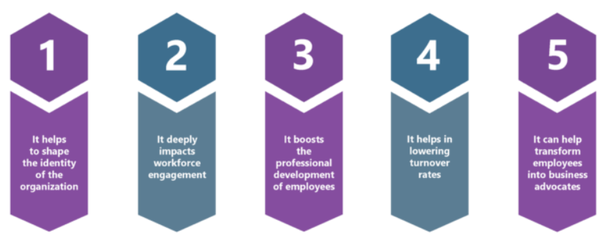
Importance of Organization Culture

Slide 11
Role of culture in shaping employee behavior and organizational performance
Shaping Attitudes and Values: Organizational culture is a powerful determinant of employee attitudes and values. Shared experiences, rituals, and interactions within the organization help employees internalize its values and norms. For instance, a culture that emphasizes innovation and risk-taking can cultivate employees who are more open to new ideas and willing to take calculated risks, thereby driving business growth.
Establishing Behavioral Expectations: Organizational culture sets clear behavioral expectations. It defines what behaviors are acceptable and what aren't. In a culture that values customer-centricity, for example, employees are expected to prioritize customer satisfaction. This alignment of expectations with the culture standardizes behavior across the organization.
Encouraging Collaboration and Teamwork: Some organizational cultures promote collaboration and teamwork. In these environments, employees are more likely to work together, share knowledge, and support each other, positively impacting productivity and project outcomes.
Nurturing Leadership Styles: Organizational culture also influences leadership styles within a company. Leaders often reflect and reinforce the cultural values, serving as role models for employees. For example, a culture that values transparency and open communication is likely to foster leaders who exhibit these traits, subsequently influencing employee behavior.

Slide 12
Contd…
Impact on Business Outcomes: The influence of organizational culture on employee behavior significantly shapes broader business outcomes. This part explores how employee behaviors, shaped by organizational culture, translate into tangible results for the organization.
Employee Retention: A culture that aligns with employees' values and offers a positive work environment can significantly reduce turnover rates. When employees feel a strong cultural fit, they are more inclined to stay with the company long-term, thereby reducing recruitment and training costs and preserving institutional knowledge.
Customer Satisfaction: The impact of culture on employee behavior often extends to customer interactions. A culture that prioritizes customer-centricity and exceptional service typically results in higher levels of customer satisfaction. Satisfied customers are more likely to become loyal, repeat customers and brand advocates.
Encouraging Collaboration and Teamwork: Some organizational cultures promote collaboration and teamwork. In these environments, employees are more likely to work together, share knowledge, and support each other, positively impacting productivity and project outcomes.

Slide 13
Cultural Alignment and Strategic Fit
Cultural Alignment: Cultural/Strategic alignment is the degree to which the strategy, structure, culture, and resources are aligned with the vision, mission, and values of the organization. It means that the organization have a clear and coherent direction, and that everyone understands and supports it. Cultural alignment helps to create a shared purpose, foster collaboration, and enhance performance. It is the positioning organizational culture, values, and goals with its employees.
Strategic Fit: Strategic fit is the degree to which the strategy, structure, culture, and resources are aligned with external environment. It means that the organizations have a good understanding of customers, competitors, suppliers, and other stakeholders, and that it can adapt and respond to their needs and expectations. Strategic fit helps to create a competitive advantage, foster innovation, and enhance resilience.

Slide 14
Why do they matter?
Strategic alignment and strategic fit are both essential for achieving strategic objectives and creating value for the stakeholders. However, they are not always easy to achieve or maintain, and they can sometimes conflict with each other.
For example, a company may have a strong strategic alignment within organization, but the strategy may not fit well with the changing market conditions. Or, the company may have a good strategic fit with the external environment, but the internal alignment may be weak or inconsistent. These situations can create challenges and risks for your organization, such as losing focus, wasting resources, missing opportunities, or facing resistance.

Slide 15
How do you balance them?
Balancing the cultural alignment and strategic fit is an ongoing process that requires monitoring, evaluation, and adjustment.
The organization must be aware of the trade-offs and tensions that may arise between them, and find ways to resolve or mitigate them. To do this, the management should communicate their vision, mission, values, and strategy to internal and external stakeholders, and ask their feedback.
Additionally, align the incentives, rewards, and recognition systems with the strategy and performance goals. Encourage a culture of learning, experimentation, and adaptation, and embrace change and uncertainty as opportunities for improvement and growth.

Slide 16
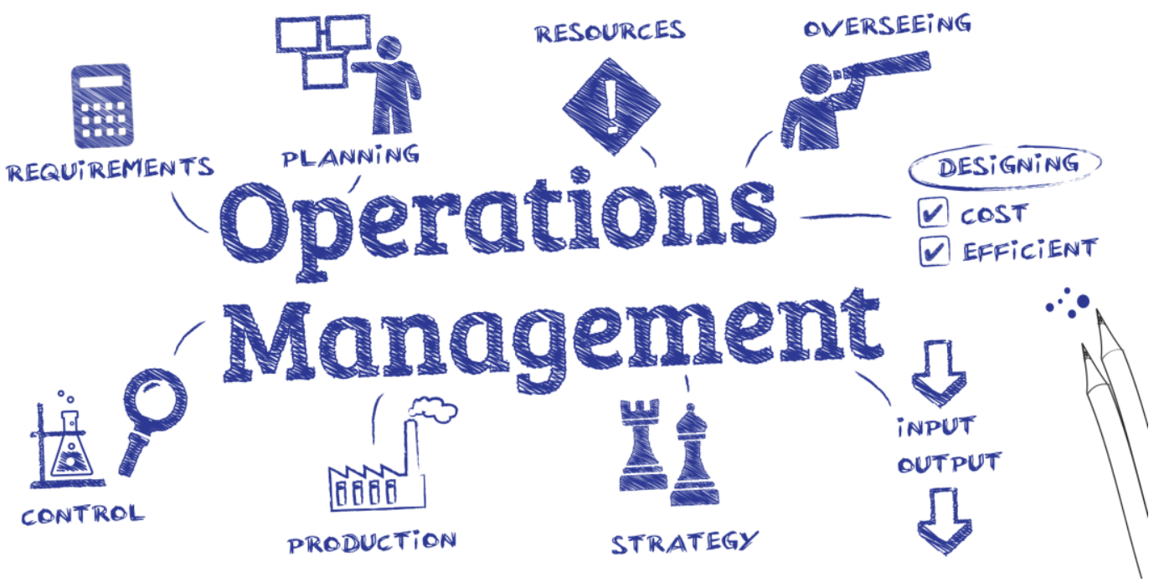
Operations Management
Operations management (OM) is the administration of business practices to create the highest level of efficiency possible within an organization. It is concerned with converting materials and labor into goods and services as efficiently as possible to maximize the profit of an organization.
In other words, it is a field of business concerned with the administration of business practices to maximize efficiency within an organization.
Operations management involves managing the operations and processes of an organization.
Some of the functions performed by an operations manager include supply chain management, product design, forecasting, quality control, and delivery management.
An operations manager must have excellent organizational, coordination, and people skills and must be tech-savvy.

Slide 17
Supply Chain and Logistics management
Supply Chain Management involves all the activities essential for production planning to delivery of final products to the customers.
Logistics management includes all the activities of planning, implementation and control and storage of goods, services and related information

Slide 18
Principles of Operations Management
Customer Focus: Operations should be aligned with customer needs and preferences. Understanding customer requirements and delivering products or services that meet or exceed their expectations is essential.
Continuous Improvement: Emphasizing continuous improvement through techniques like Lean management, Six Sigma, or Total Quality Management (TQM) helps in identifying and eliminating inefficiencies, reducing waste, and enhancing overall performance.
Efficiency: Operations should strive to achieve maximum efficiency by optimizing resources such as labor, materials, equipment, and time. This involves streamlining processes, reducing bottlenecks, and minimizing unnecessary steps.
Quality Management: Ensuring high-quality products or services is paramount. Quality management involves establishing and maintaining quality standards, implementing quality control measures, and fostering a culture of quality throughout the organization.
Flexibility and Adaptability: Operations should be flexible and adaptable to changing market conditions, customer demands, and technological advancements. This requires agile processes, responsive supply chains, and the ability to quickly adjust to unforeseen circumstances.

Slide 19
Contd…
Fact-based decision making: In order to know how well an organization is performing, data on performance measures are necessary. TQM requires that an organization continually collect and analyze data in order to improve decision making accuracy, achieve consensus, and allow prediction based on past history.
Continual improvement: A large aspect of TQM is continual process improvement. Continual improvement drives an organization to be both analytical and creative in finding ways to become more competitive and more effective at meeting stakeholder expectations.

Slide 20
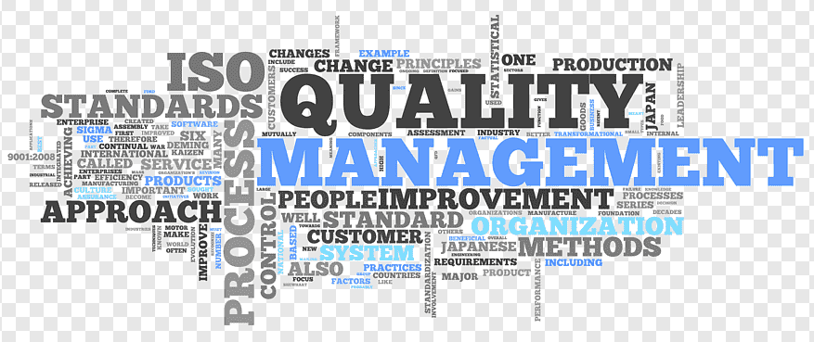

Slide 21
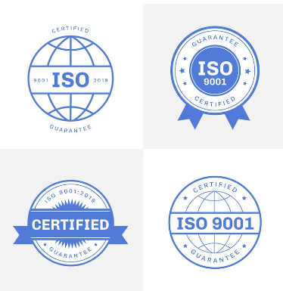
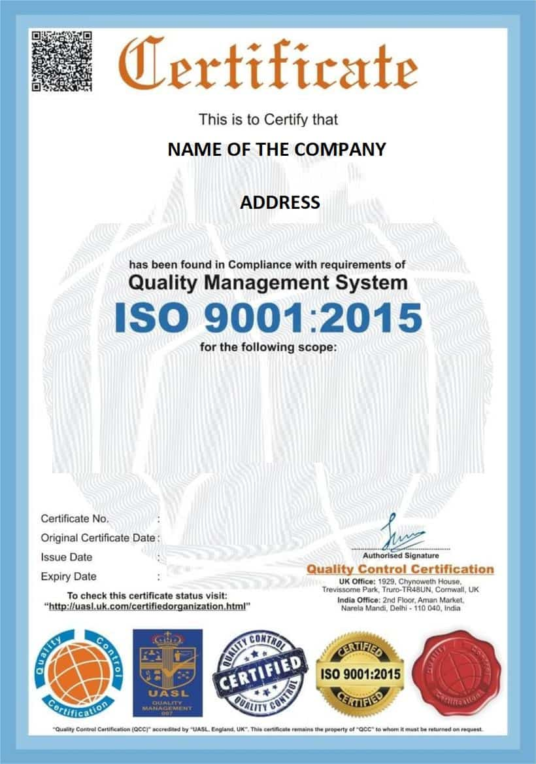

Slide 22
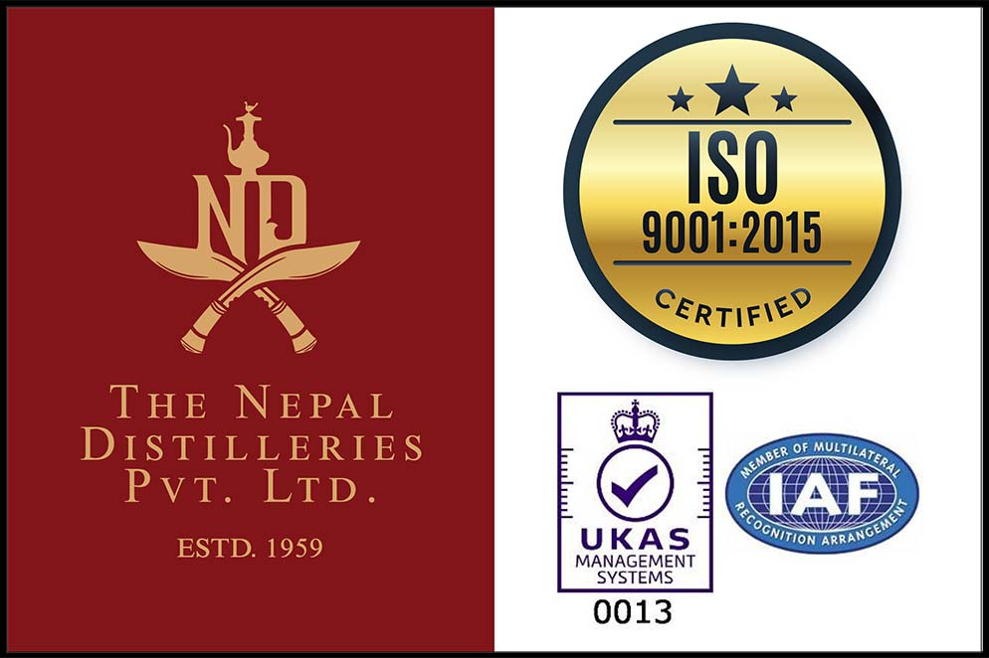

Slide 23
What is TQM?
Total Quality management is defined as a continuous effort by the management as well as employees of a particular organization to ensure long term customer loyalty and customer satisfaction.
One happy and satisfied customer brings ten new customers along with him whereas one disappointed individual will spread bad word of mouth and spoil several of your existing as well as potential customers.
Total quality management is a structured effort by employees to continuously improve the quality of their products and services through proper feedbacks and research. Ensuring superior quality of a product or service is not the responsibility of a single member.

Slide 24
What is ISO?
ISO stands for International Organization for Standardization.
ISO certification certifies that a management system, manufacturing process, service, or documentation procedure has all the requirements for standardization and quality assurance.
ISO is an independent, non-governmental, international organization that develops standards to ensure the quality, safety, and efficiency of products, services, and systems.
If an organization bills themselves as "ISO 9001 Certified," this means the organization has met the requirements designated under ISO 9001
ISO 9001 requires organizations to define and follow a quality management system that is both appropriate and effective while also requiring them to identify areas for improvement and take action toward those improvements.
As a result, it's typically understood that an organization claiming ISO 9001 certification is an organization with products and services that meet quality standards.

Slide 25
Principles/Elements of TQM
Customer-focused: The customer ultimately determines the level of quality. No matter what an organization does to foster quality improvement—training employees, integrating quality into the design process, or upgrading computers or software—the customer determines whether the efforts were worthwhile.
Total employee involvement: All employees participate in working toward common goals. Total employee commitment can only be obtained after fear has been driven from the workplace, when empowerment has occurred, and when management has provided the proper environment.
Strategic and systematic approach: A critical part of the management of quality is the strategic and systematic approach to achieving an organization’s vision, mission, and goals. This process, called strategic planning or strategic management, includes the formulation of a strategic plan that integrates quality as a core component.

Slide 26
Contd…
Cost Management: Managing costs effectively is essential for profitability and competitiveness. This involves controlling expenses, optimizing resource utilization, and identifying opportunities for cost reduction without compromising quality or customer satisfaction.
Supply Chain Management: Operations management extends beyond the boundaries of the organization to encompass the entire supply chain. Effective supply chain management involves coordinating activities with suppliers, distributors, and other partners to ensure seamless flow of materials, information, and value.
Risk Management: Identifying and mitigating risks is crucial for ensuring continuity of operations. This includes assessing potential risks such as supply chain disruptions, natural disasters, or market fluctuations, and implementing strategies to minimize their impact.
Employee Empowerment: Engaging and empowering employees is essential for driving operational excellence. This includes providing training and development opportunities, fostering a culture of collaboration and innovation, and recognizing and rewarding contributions to continuous improvement.

Slide 27
What is Human Resource Management (HRM)?
Human resource management (HRM) is the practice of recruiting, hiring, deploying and managing an organization's employees.
Human resource management (HRM) is the process of employing people, training them, compensating them, developing policies relating to them, and developing strategies to retain them.
Human Resource Management deals with the management functions like planning, organizing, directing and controlling
It deals with obtaining human resource , training & development and maintenance of human resource.
Human Resource Management is a multidisciplinary subject.
It includes the study of management, psychology, communication, economics and sociology.
It also deals with building team spirit and team work.
It is a continuous process.

Slide 28
Characteristics of HRM
Managing people at work or people oriented: While managing their affairs at work is a given, excellent HR management considers everything that surrounds us as people.
Concerned with employees: The quicker HR professionals understand that a business runs most efficiently when its employees are happy, the better the outcome.
Concerned with development of employees: The focus of this HRM characteristic should be to let employees know that there is room for career growth. HR management teams must help employees set realistic, time-bound goals for their growth in the organization.
Continuous in nature: A vital characteristic of HRM is constantly being aware of how employees are doing, how effectively they are doing it, and how they feel about performing their jobs.
Notes:
An example where being employee-oriented should be a must-have characteristic of HRM is when an employee is consistently late for work. Then, it isn’t time to walk up to them and hand them a warning letter. Instead, investigate what’s going on in their lives that you could help with.

Slide 29
Future Oriented: Preparing for the future is vital, whether it is the future of the company’s growth, changes in culture, change in the work environment, or meeting new trends or future employee requirements.
Mutual Benefit: HRM aims to create a mutual environment where the employees and the organization benefit equally. This promotes collaboration, mutual trust, and respect among employees and management. So, in this situation, the organization achieves its goals while providing fair opportunities for growth and development for the employees.

Slide 30



Components of HRM
Acquisition
Human Resource Planning
Recruiting (internal and external)
Employee Socialization
Development
Employee Training
Management Development
Career Development
Motivation
Job Design
Performance Evaluation
Rewards
Compensation/Benefits
Discipline
Maintenance
Safety and health / Labor relations

